Slide 1
Personnel Development Program Data Collection System (PDPDCS)
Richelle davis, OSEP michelle bloom, Program coordinator
Mia Leland, data manager & Technical Assistance Lead myriell Mckinnon, technical assistance lead
January 24, 2023

Slide 2
Training Agenda
Review and demonstration of PDPDCS
Required actions for data submission
Protecting scholar data
Available resources for grantees and scholars
Questions and Discussion
Notes:
For today’s training, we will be demonstrating how to submit scholar data in the PDPDCS, focusing on using the digital pre-scholarship agreement and exit certification. We will then go over the recent changes to the site, share reminders about avoiding security incidents, and review the currently available resources. Again, if you have any questions during the presentation, please type them into the chat. We will also be answering questions at the end of the presentation.

Slide 3
Adding New scholar records

Slide 4
Activities to complete in the PDPDCS for Enrolled Scholars
Log into the PDPDCS and verify secondary user(s)
Review your data summary
Add any new scholars
Update scholar records for each enrolled or enrolled, no longer funded scholars
Review and submit all data by March 31st deadline
Notes:
Before we get to the demo, here are a few things to note. During the data collection period, you will need to complete all of these steps and update the record for each enrolled scholar.
Although the system is available year-round, at the end of the data collection period grantees are required to have all scholar data up-to-date for all scholars who were enrolled during the previous fiscal year. We recommend logging into the system to make these updates at least every 6 months.
If you have not submitted all your scholars or some scholars are missing critical information, the PDPDCS Help Desk will contact you and your OSEP project officer to correct these issues immediately.

Slide 5
Signing into the PDPDCS using Multifactor Authentication (MFA)
Each time you sign into the PDPDCS from any device you will need to complete these 3 steps:
Enter your username and password in the PDPDCS.
Open the Google Authenticator app on your smartphone and take note of the 6-digit security code generated by the app.*
Enter the 6-digit security code into the PDPDCS when prompted by the system (prompt will occur after you enter your username and password).
*Remember: Each code is only valid for thirty seconds
Notes:
These are the steps you must follow to login to the PDPDCS. Each time you sign in, you will need to enter your username and password and complete the multifactor authentication using the Google Authenticator app. If you lost your smartphone or are having any trouble with MFA, please contact the Help Desk and we can reset it or assist you.
If you have more questions or would like more help using Multifactor Authentication to login to the PDPDCS, please check the training webpage for resources.

Slide 6

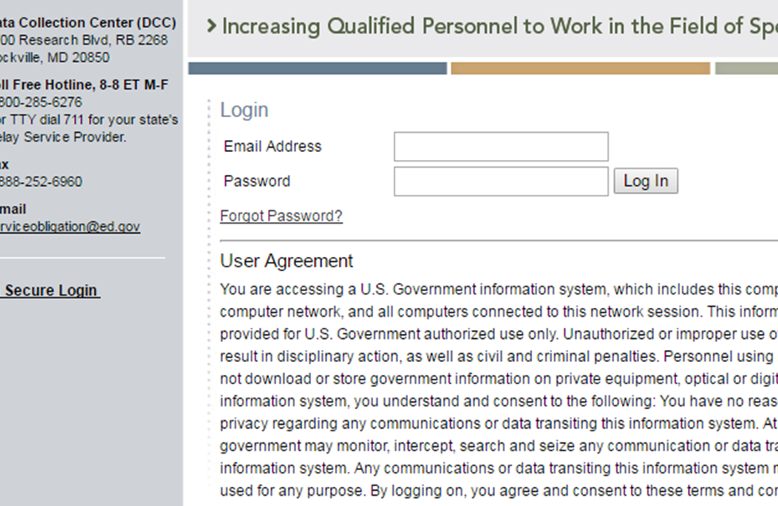
How do I reset my password?
Use the “Forgot Password” link on the login page.
Notes:
If you cannot remember your password, you will need to go to the login page to request a new password. Click “secure login” on the PDPDCS home page, the select “Forgot Password” and enter your email address. You will then receive an email from serviceobligation@ed.gov with instructions to reset your password and login again.

Slide 7
Adding a Secondary User
Project Directors (PDs) are responsible for all data entries; however, secondary users are permitted to assist in the process.
Secondary users:
  Can enter scholar information, and
  Have a unique log in.
Notes:
Project Directors are strongly recommended to add at least one secondary user to assist with data entry. PDs are handling a lot of information and a trusted secondary user can ease some of the burden. Secondary users accounts are often used for a co-PI or graduate assistant.

Slide 8
Multiple Secondary Users
Only three people per grant may enter or access scholar information.
  Project Directors may change the secondary user(s) at any time and should review who has access at least annually.
Note: You may NOT create a shared inbox for your secondary user – each user requires a unique login.
Notes:
Last year we added the option for Project Directors to add a third secondary user.
Remember, if you have multiple secondary users, both secondary users must have a unique login information to access the PDPDCS.
Do not create a shared inbox for additional grant users – this can create a data security issue, which we will cover a little later in this presentation.

Slide 9

Timeline for Enrolling Scholars
Enter and submit scholar contact and enrollment information within 30 days of scholar enrollment in the degree program.
The scholar must have:
  Registered for classes
  Received “scholar support” from
  grant project
  Signed PSA
Notes:
Once logged into the PDPDCS, grantees will need to enter information about enrolled scholars. You must enter and submit scholar information into the PDPDCS within 30 days of a scholar “enrollment” in the program. That is, within 30 days of the scholar -
Registering for classes
Receiving funding from the PDP grant project
And signing the Pre-Scholarship Agreement, which can be done digitally. Once the PSA is finalized, grantees will still need to finish creating and submitting the scholar record.
Typically, entering and submitting scholar information into the PDPDCS occurs within 30 days of the start of the first semester. It would not be prior to classes beginning.

Slide 10
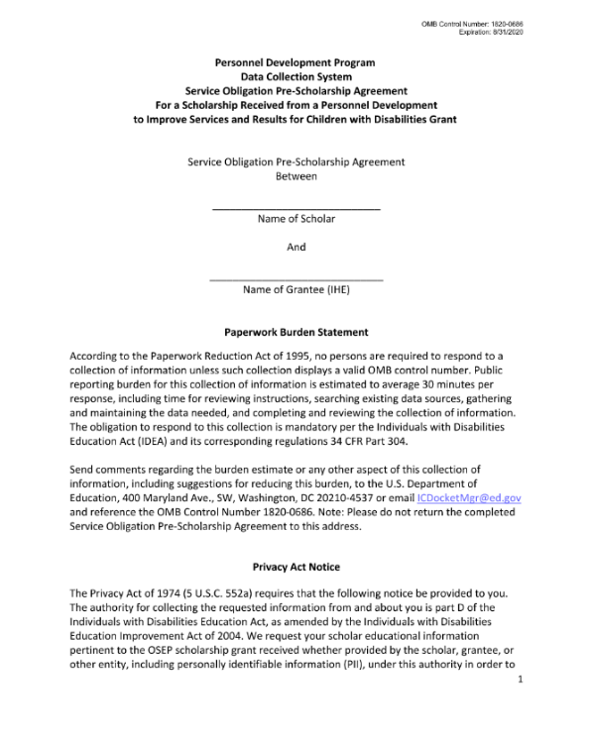
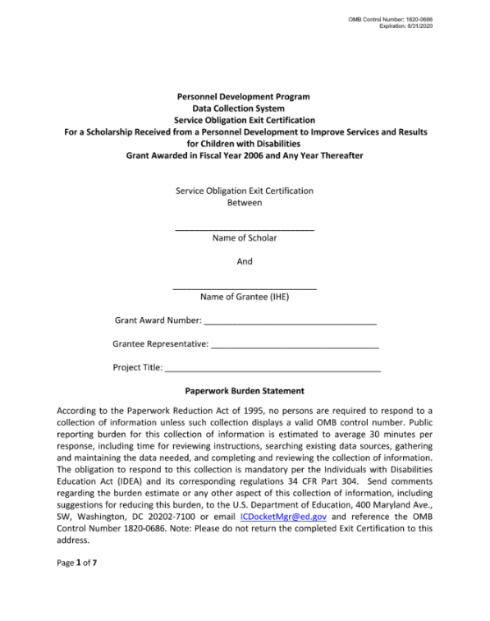
Pre-Scholarship Agreements (PSA) and Exit Certifications (EC)
Grantees and scholars must sign an OMB-approved PSA and EC for each funded scholar.
  Scholar records cannot be created without a PSA.
Grantees may be held responsible for funds provided to scholars with missing or invalid documents.
Grantees must retain all grant
records until each scholar’s
service obligation has been
fulfilled or paid back.
Notes:
When enrolling scholars, the Project Director and the scholar must both sign the Pre-Scholarship Agreement. The legally binding PSA outlines the terms and conditions of PDP funding. You, as grantees, are responsible for the accuracy and maintenance of these documents for funded scholars. If you choose to use the digital version of the PSA, please make sure you download and save a copy.
Grantees must retain grant records until all service obligation has been fulfilled or paid back. So please stay in touch with scholars until they have completed their service obligation.

Slide 11
Digital PSA Process Overview
Grantee initiates the PSA and fills in scholar information
Scholar receives email notification to review digital PSA
Scholar reviews PSA
PD Reviews PSA then signs and submits
Scholar record is created in the PDPDCS
Scholar signs PSA
Grantee receives notification to edit PSA and makes changes in PDPDCS
Scholar disagrees with information and leaves a comment
Notes:
OSEP strongly encourages that all grantees use the digital versions of the agreements to decrease potential security incidents and to avoid uploading invalid agreements.
Here is a visual overview and answers to common questions about using the digital pre-scholarship agreement.
Answers to common questions:
PDs and secondary users can initiate the digital PSA, but only the project director can sign the final agreement
You will be able to download a redacted PDF of the signed agreement from the PDPDCS.
When completing the digital agreement, grantees still need to fill out the scholar’s contact information in Section B and section C; however Section C is optional.
You will need the scholar’s SSN to create a scholar record (either using the digital process or to upload a physical PSA). If you are using the physical or PDF version of the PSA, you must redact the SSN in the PSA prior to uploading the signed agreement to the PDPDCS. If you use the digital PSA process, the PDPDCS will automatically redact the SSN in the signed version that is converted to pdf that can be downloaded by the user.

Slide 12
Live Demonstration
DEMO 1:
Logging into the PDPDCS using MFA
Adding secondary user(s)
Creating a Digital Pre-Scholarship Agreement for a newly funded scholar
Completing and submitting the scholar record
Notes:
Please go to https://youtu.be/EjgQkAaIdQk to view the live demonstration.

Slide 13
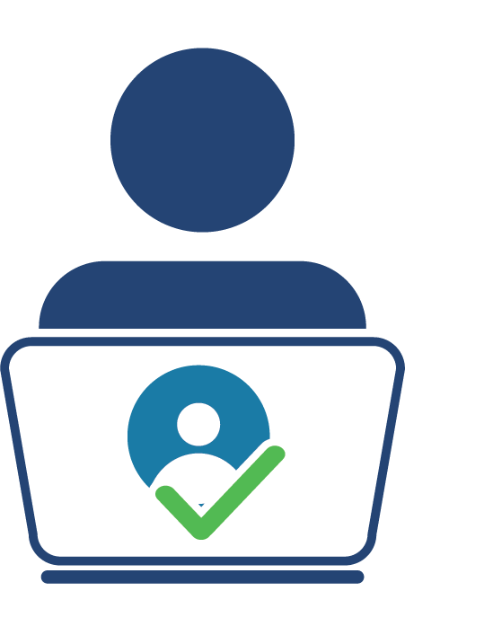
Pending Scholars
OSEP requires that scholars are in a pending status for no more than 30 days.
Help Desk staff will contact you and your Project Officer if your grant has scholars in a pending status at the end of each annual data collection period.
Notes:
Remember, scholars whose information has been entered and “saved for later” will be in a pending status. Scholar records must be “submitted” to ensure their information is complete. Clicking “save and submit” on each scholar record will allow the scholar to access their record within the PDPDCS and begin entering eligible employment, if applicable.
Scholars cannot remain in a “pending” status for longer than 30 days and scholar records cannot be “submitted” until all required items are entered.
PDPDCS Help Desk will identify grantees who fail to “submit” timely, accurate, and complete scholar data and will take appropriate actions, including referring to OSEP any noncompliant grantees. Your project officer will then contact you to discuss why you have not submitted scholar data.

Slide 14
Updating and exiting scholar records

Slide 15
Activities to complete in the PDPDCS Part 2
Update the training, funding, and completion status sections for each enrolled scholar:
  Section G: Current Training Program Information
  Section H: Employment Information During OSEP Grant Program
  Section I: Scholar Status
Enter exit information for scholars no longer enrolled (Section J)
Review and submit all data by March 31st deadline
Notes:
Once scholars have been entered into the PDPDCS, grantees will need to update scholar records at least annually during the data collection period. This includes updating the funding amounts, full or part time status, and employment during training.

Slide 16
Timeline for Updating and Exiting Scholars
Update scholar contact and program completion information within 30 days of:
  Scholar status changes
    Enrolled but no longer funded
    Exited Prior to Completion
    Graduated
  Grant budget period ending
Notes:
Apart from the updates required during the data collection period, grantees’ must update scholars’ information within 30 days of a change in a scholar’s status.
For example, you will need to change the scholar’s status in the PDPDCS within 30 days of that scholar graduating or exiting prior to completing the program. If that 30 days falls within the data collection period, you can make these updates at the same time.

Slide 17
Digital EC Process Overview
Grantee initiates the EC from the scholar record
Scholar receives email notification to review digital EC
Scholar reviews EC
PD signs EC
PD exits the scholar in the PDPDCS
Scholar signs EC
Grantee receives notification to edit EC and makes changes in PDPDCS
Scholar disagrees with information and leaves a comment
Scholars are not fully considered exited until the EC has been signed AND the scholar’s record has been submitted.
Notes:
When exiting a scholar using the digital Exit Certification, there are two steps to keep in mind. Grantees must first fill out the agreement and ensure it is signed and finalized by the PD and scholar. THEN the grantee can officially exit the scholar by completing the rest of the scholar record in the PDPDCS and submitting it.
Make sure data is correct in the scholar record BEFORE initiating a digital EC. If changes are required, you must make the necessary changes, SAVE then return to the scholar’s record to start or return to the digital agreement. You cannot make changes after the agreement has been submitted to the scholar.
The scholar will remain in an “Enrolled” status until the digital EC has been signed and finalized and the grantee completes all remaining exit information data fields.
Again, PDs and secondary users can initiate the digital PSA, but only the project director can sign the final agreement
If the estimated funding amount in the PSA differs from the final funding amount, that is fine. However, the final funding amount in the EC needs to match the funding amount shown in the PDPDCS.

Slide 18
Live Demonstration
DEMO 2:
Updating Sections G-H for a scholar
Exiting a scholar using the digital Exit Certification
Notes:
Please go to https://youtu.be/EjgQkAaIdQk to view the live demonstration.

Slide 19
Which program completion status should I select for my scholar?
Enrolled: The scholar is currently enrolled in the funded training program.
Enrolled, No Longer Receiving OSEP Funding: The scholar is currently enrolled in the funded training program but is no longer receiving OSEP funding.
Graduated/Completed: The scholar has completed the funded training program.
Exited without Completion: The scholar has exited the OSEP training program without completing the program.
Notes:
We have received some questions about program completion statuses.
The status of “enrolled, no longer receiving OSEP funding” applies to scholars who may be finishing other academic requirements at the university and have completed or paused the program. This refers to scholars who are not receiving any PDPDCS funding but have not yet graduated or completed the training program.
The graduated/completed status refers to scholars who completed the training program and typically have graduated from the university.
Lastly, if you select the exited without completion status, the PDPDCS will prompt you to include a reason for the scholar’s exit. Possible reasons include transfer to another program, health, poor academic performance, OSEP grant ending, and more. You will need to indicate the date of exit without completion and whether the scholar is expected to enroll in another OSEP grant program in the future.

Slide 20
Measure of Skills and Knowledge
Examples of Measures of Knowledge and Skills
ACCEPTABLE Measures | UNACCEPTABLE Measures
Grantee-specific tests (e.g., portfolio, comprehensive exam, dissertation defense) PRAXIS II National organization tests State-specific tests Capstone project or exam required of scholars prior to degree program or grant project completion | Entrance exams (e.g., PRAXIS I, GRE, SAT) University preliminary exams Individual course exams or grades
Notes:
When a scholar graduates or completes the program, you will need to indicate whether the scholar completed a measure of knowledge and skills. This slide shows examples of acceptable measures and unacceptable measures that would demonstrate that a scholar is knowledgeable and skilled in use of Evidence-Based Practices for children with disabilities, which is one of the Program Performance Measures that is reported to Congress.
Grantees are required to report on this measure. In recent years, grantees have not been consistently reporting to PDPDCS on this measure. Please make sure you are gathering this information from scholars and reminding them BEFORE they exit that they must report their measure or exam results to you. We recommend that you conduct an exit interview with each scholar and include an item related to measuring knowledge and skills.
If you need to exit a scholar prior to receiving the results of a measure of skill and knowledge, you can always contact the Help Desk and we would be happy to update that information for you.

Slide 21
Exit All Scholars BEFORE Your Grant Ends
Any scholar who has not graduated/ completed or previously exited at the time a grant closes will need to be assigned the status of “exited without completion.”
  Project Directors are responsible for obtaining Exit Certifications from these scholars too. Service obligation requirements still apply.
As you “exit” each scholar, you will report the reason or final status for each scholar.
Notes:
When OSEP funding ends, at the conclusion of a grant, it is the responsibility of the grantee to “exit” all scholars in PDPDCS. Grantees will “exit” scholars either as graduated/completed or exited without completion for a specific reason. If you choose “exited without completion” because your grant has ended, please select the option “OSEP support terminated due to OSEP grant ending.”
ALL scholars MUST sign an Exit Certification upon exiting the program and grantees MUST exit all scholars before submitting the Final Performance Report.
PDPDCS staff will work with grantees and OSEP to assist in making sure all scholars are in an “exited” status at this time.
We have created an end-of-grant checklist for grantees to help you understand what is required to begin the process to close-out your grant. This can also be found on the training page at OSEP-PDPDCS-Final-Closeout-Checklist_v1b.pdf (ed.gov)

Slide 22
Managing PDPDCS Grants and Timelines
Project Directors must manage grants to ensure that:
All scholars can complete the degree program before the grant ends;
Scholars are enrolled early (Year 1) with sufficient time, funding, and support to complete the program; and
The number of scholars proposed, enrolled, and completed meets outlined expectations.
Contact your OSEP Project Officer to discuss changes in the number of or completion status of scholars.
Notes:
It is up to the grantee to ensure that scholars are enrolled with enough time, funding, and support to complete the training program within the grant project period. You need to manage the grant so that all scholars complete the program before the grant ends.
A Department priority over the past several years is for projects to end within the established grant project period. OSEP may consider grantees request for a one-time, no cost extension to allow more time –up to 12 months, no new money– for scholars to complete the preparation program and graduate. We want scholars to “complete” the program and be counted as program completers! Please make sure you are making these timing considerations when recruiting.
A second no-cost extension is unlikely to be approved. Once again, it is important that scholars are recruited and can complete their training program by the end of the grant project period.

Slide 23
Submit Data for ALL Scholars by March 31st
  Federal Regulations:
  According to 34 CFR 75.253(a)(3), the timely
  submission of this report is one of the
  factors that the Secretary will consider in
  determining whether to continue your
  project's funding for the next fiscal year
  According to section 75.217(d)(3)(ii), the Secretary can consider the failure to submit scholar data in a timely fashion in determining your project’s ability to obtain future grants from the Office of Special Education Programs or under any other Department program.
Notes:
Make sure that by the deadline of March 31st 2023, you have entered and submitted records for all currently enrolled scholars (meaning scholars who enrolled before March 31st) AND updated the records for scholars who have graduated or exited prior to completion.
If you have scholars that are in a “pending” status after the conclusion of the data collection period, PDPDCS will notify you and your OSEP project officer. All noncompliant grantees will be reported to OSEP. Project Officers will then contact those project directors to determine what barriers are preventing the grantee from submitting their scholar data as required and in a timely manner.
Remember that the Secretary can consider failure to submit scholar data in a timely fashion in determining your project’s ability to obtain future grants from OSEP or under any other Department program.
If you have any questions about submitting data or using the PDPDCS, you can always contact the Help Desk and one of our associates would be happy to help you!

Slide 24
Scholar faqs

Slide 25
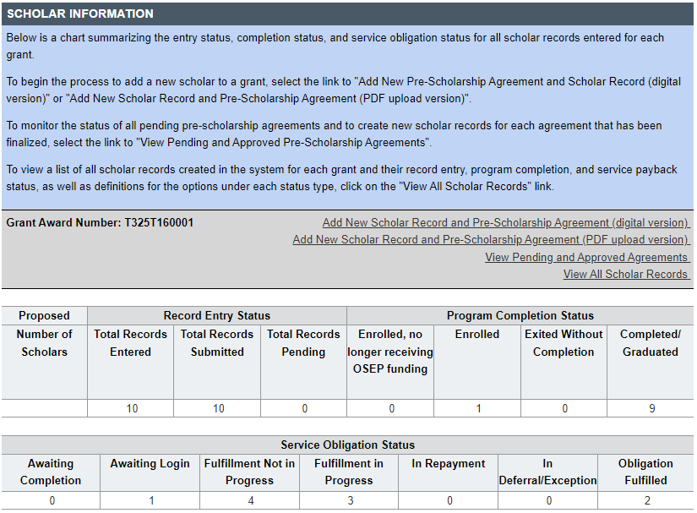
How do I know if my scholars have logged into the PDPDCS?
Notes:
You should monitor the service obligation status of all scholars in your program using the summary tables that display counts of scholars in each service obligation status. Under the service obligation status header, you will be able to easily see which scholars have not yet logged in or begun fulfilling their service obligation. If a scholar has a status of “fulfillment not in progress”, this means either the scholar has not yet entered employment information into the PDPDCS, or the scholar has submitted an employment record, but it has not yet been verified by their employer.
An explanation of the other statuses is listed at the top of the page. Grantee support will ensure OSEP has the data it needs to report on PROGRAM Performance Measures and service obligation results to Federal government authorities.

Slide 26

What do I need to tell scholars?
Clearly explain the following to your scholars before they accept funding:
Exiting prior to one academic year of enrollment requires a cash payback (no option for fulfillment through service).
After one academic year, scholars may begin fulfilling their obligation through service.
Scholars should update employment information every 6 months to display accurate count of service obligation.
Notes:
Pre-Scholarship Agreements (PSA) and Exit Certifications (EC) (https://pdp.ed.gov/OSEP/Home/Agreements/)
2006 Service Obligation Regulations (https://pdp.ed.gov/OSEP/Regulation/ProgramRegs2006)
Regulatory Frequently Asked Questions available at: (https://pdp.ed.gov/OSEP/Home/regulatoryfaqs)
In addition to the PSAs and ECs, you should disseminate to scholars' copies of the current regulations and the frequently asked questions (FAQs). Please explain clearly to your scholars these service obligation requirements before they agree to accept. Continue to remind scholars throughout the program about the requirements and that they will need to submit employment information.
Scholars must complete 1 academic year before they may begin to fulfill their obligation through service. Exiting prior to one academic year of enrollment in program requires a cash payback. Grantees are responsible for updating the PDPDCS with the date that their scholars have completed one academic year. If you do not update scholar records with this date, scholars will not be able to enter their employment information at the one-year mark.

Slide 27
When should scholars log in?
Scholars must login to the PDPDCS within 30 days of receiving access to the system and then continue to do so every 6 months until they fulfill their service obligation to:
  Review and update contact information;
  Review training and service obligation information; and
  Submit employment information.
Notes:
You know and see your scholars, so remind them that once they receive the email with instructions for accessing the PDPDCS (which is sent to them as soon as you “submit” their record in the system), they need to login. Scholars must login to the PDPDCS during enrollment to ensure they can access the system prior to exiting or graduation.
Continue to talk with your scholars throughout the program about their service obligation. Inform them and remind them of the need for them to (a) enter employment information and (b) ask their employer to login and verify their employment so they can begin fulfilling their service obligation.
Our Help Desk has received many questions about this: The service obligation calculator will only update once employers complete the verification process. Only previously completed employment can be credited towards the service obligation. We recommend scholars login every 6 months to update their employment to display an accurate status.

Slide 28

Why aren’t I (or my scholars) receiving emails from the PDPDCS?
To ensure you and your
scholars receive all system
notifications:
Add
Add serviceobligation@ed.gov to your contact list;
Check
Check email settings to be sure emails from this account are not marked as spam; and
Enter
Enter a non-IHE email address for each scholar.
Notes:
PDPDCS and Help Desk will contact scholars via email from serviceobligation@ed.gov through the primary email address entered for them in the system. Make sure that you enter a non-university email address (a personal or work email address) for scholars since many of them will lose access to their university email after graduation. Scholars need to access the PDPDCS for several years after completion or graduation to fulfill their service obligation.

Slide 29

What information do scholars need to provide?
Information collected includes:
  Employer contact information;
  Type of organization;
  Dates of employment;
  Type of employment;
  Full or part time position;
  Training area(s);
  Whether or not the position meets requirements for service obligation fulfillment
  Certification or licensure
Notes:
To complete their employment record, scholars will need to provide:
Contact information of their employer’s organization as well as contact info for a supervisor and/or HR representative
The type of organization, which offers options like a school, hospital, non-profit and others
When the scholar started and, if applicable, ended at this position
The type of employment, meaning is the scholar a special education teacher, a special education paraprofessional, an administrator or supervisor, etc.
If it is a full or part time position
The training area or areas, which line up with the options that grantees will choose for the scholar’s training program
If the scholar spends at least 51% of their time serving special education students and if the percentage of special education students served is over 51%
And lastly, if the scholar has received the appropriate certification or license for this position.
There is a link on the training page with screenshots of the scholar’s employment record if you would like to take a closer look.

Slide 30
What else do I need to tell scholars?
Scholars are responsible for ensuring
their submitted employment is
reviewed and verified by their employer.
Scholars who do not have their
employment verified by the time their service obligation must
be fulfilled will be
referred to ARBMD for
cash payback.
Notes:
Scholars who do not submit eligible employment information that is verified by their employer by the time their service obligation must be fulfilled are not in compliance and will be referred to ARBMD for repayment.
Again, the service obligation calculator will only update once employers verify a scholar’s employment record, so please remind your scholars to update their employment every 6 months to display an accurate status.
The burden to ensure that scholars receive credit for their obligation falls onto SCHOLARS. Once you have exited a scholar, you will no longer be able to make changes to that scholar record. You should remind scholars to login and complete their employment records, but they must ensure their employment is verified in the system to receive service obligation credit.
Both legal and ethical issues are associated with service obligation, and we encourage you to talk with scholars about the importance you place on fulfilling this professional obligation.

Slide 31
Avoiding Security Incidents
Notes:
During this section, we will define security incidents within the context of the program (PDP) and how to avoid them. We will also cover what happens after a security incident occurs.

Slide 32

Security Incidents
A security incident occurs if personally identifiable information (PII) is potentially viewable to unrelated parties.
Examples from PDPDCS:
  Uploading an unredacted Pre-Scholarship Agreement (PSA) to the wrong scholar record
  Sending unencrypted documents
  (Social Security Card, Driver’s
  License, etc.) in an email to the
  PDPDCS Help Desk
Notes:
Scholar agreements and records within the PDPDCS contain significant amounts of scholar’s personally identifiable information (PII).
It is the responsibility of the grantees to protect this scholar information. Improperly handling PDP documentation could expose a scholar to potential identity theft and impact the university’s ability to receive future funding from the Department.
We recommend using the digital PSA feature to avoid potentially uploading an unredacted document to the wrong scholar record.

Slide 33
Impacts of Security Incidents on Department Staff
PDPDCS staff must notify the Department’s Education Security Operation Center (EDSOC), document the incident, and expunge the file or email from the servers
Additional interviews, investigations, and mitigation strategies may be necessary
PDPDCS Staff must review all other scholar records and documentation associated with the grantee
Notes:
Every security incident that occurs requires significant resources from the Department to mitigate the impact. These steps require hours of paperwork and Department resources to address. Further, we all want to do our part to protect PII of scholars.

Slide 34
Impacts of Security Incidents on Grantees
Grantees must resubmit scholar documentation, complete security incident report, and participate in investigation interviews as needed
Project Directors and Secondary Users will be required to participate in a security training to understand the proper handling of scholar PII and the consequences of data breaches
The grant will be placed on a security incident list tracked by PDPDCS and OSEP staff. If further incidents occur, the grant and university could be placed on high-risk status, impacting their ability to receive future federal funding
Notes:
In addition to the potential effects of sharing PII, grantees may also encounter these consequences as result of one or multiple security incidents.

Slide 35
Avoiding Security Incidents
Always encrypt files being sent by email, including to the PDPDCS Help Desk.
Use the digital Pre-Scholarship Agreements and Exit Certifications to avoid uploading a document to the wrong scholar record.
Implement a file naming convention to track files associated with each scholar’s record: PSA_J_DOE.pdf.
Notes:
More information on avoiding security incidents and how to encrypt files is available on the PDPDCS training webpage and we will put a link to this resource in the chat.

Slide 36
Resources and Support

Slide 37
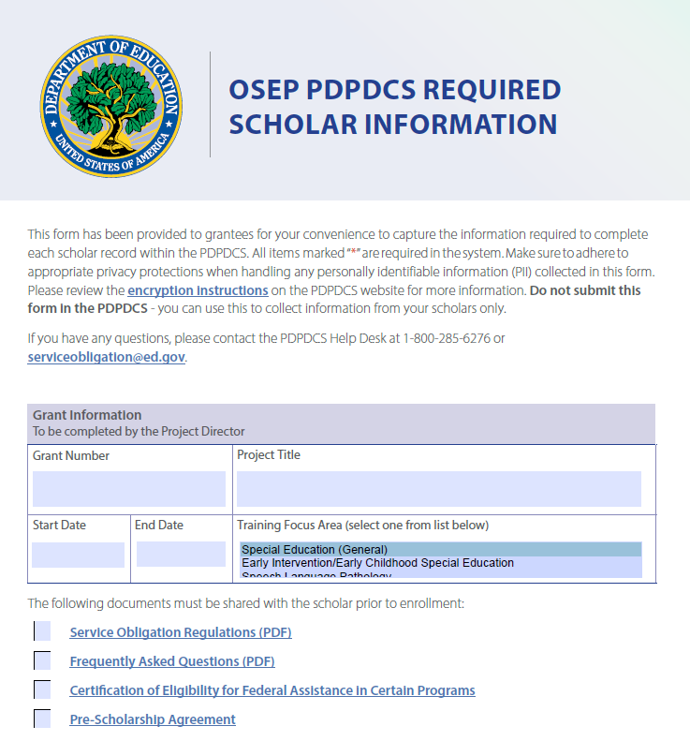
New PDPDCS Resource
Reference document to assist grantees with collecting information from scholars
Not to be submitted into PDPDCS
Adhere to privacy protections
Notes:
Based on feedback we have received from grantees, our team created a new resource to help you gather the information required to fill out the scholar record in the PDPDCS. This fillable PDF can be sent to scholars to have them enter their contact information. If you choose to utilize this tool, you must adhere to privacy protections. We recommend using encryption or password protection when sending this document back and forth. Please DO NOT send this document to the Help Desk.
Once you have gathered the information from the scholar in this document, you can then use it to complete the scholar’s record in the PDPDCS and submit it.
This resource has been posted on the website. We will also share it with you via email in the coming weeks.

Slide 38

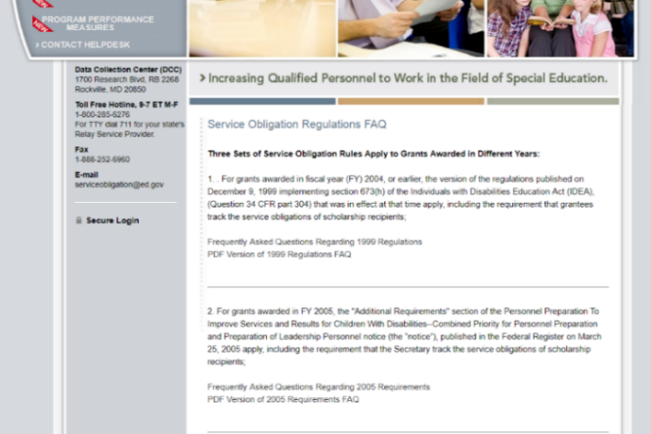
PDPDCS Resources
PDPDCS resources (https://pdp.ed.gov/OSEP/Home/Training) include:
  Annual Webinar Recordings
  Annual and Final Checklists
  Scholar Reference Guide
  Employer Tip Sheet
  MFA Training PPT/Video
  Screenshots of PDPDCS
PDPDCS Frequently Asked Questions
(https://pdp.ed.gov/OSEP/Home/dcsfaq)
Notes:
Many resources are available on the PDPDCS Training webpage including those listed here. And we always encourage you to review the FAQs.

Slide 39
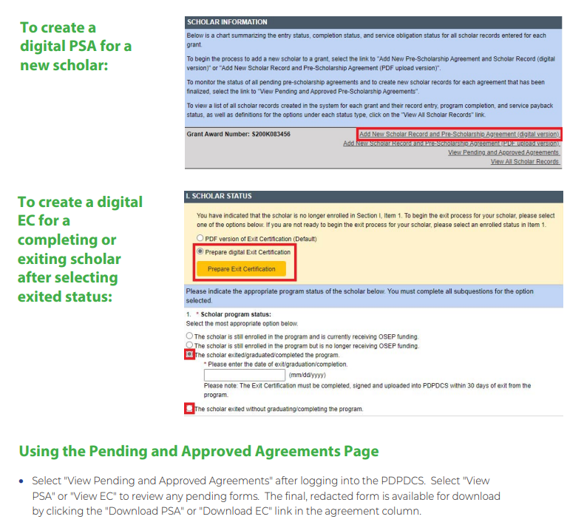
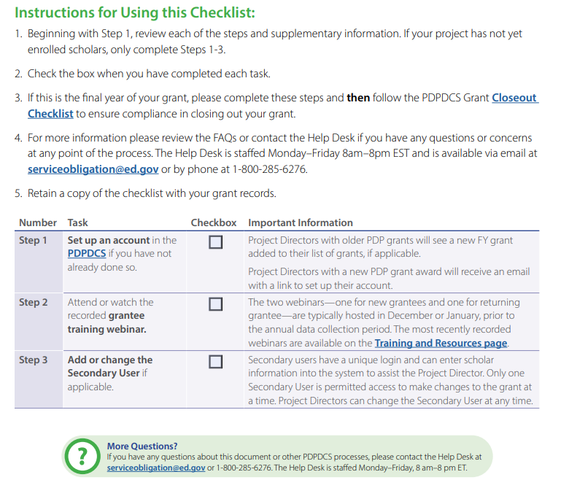
Other Helpful Resources
Digital PSA and EC Information
Annual and Final Closeout Checklists
Notes:
We want to highlight a couple of additional resources that are available to you. The Digital PSA and EC information sheet answers frequently asked questions about the process and forms and the Annual Checklist is a PDF for grantees to use each year to ensure they are correctly and fully making updates to the PDPDCS. The Final Closeout Checklist is another PDF checklist for grantees to use in the final year of their grant to ensure they are completing all necessary tasks during that last year.
You can also find security resources, like those mentioned previously including the security incidents fact sheet and steps to encrypt files on the training page.

Slide 40
Questions and Discussion
More questions?
PDPDCS Help Desk
  Support available from 8 am to 8 pm EST
  Monday through Friday
  1-800-285-6276
  For TTY dial 711 for your state’s Relay Service Provider
  serviceobligation@ed.gov
Notes:
A recording of this webinar will be made available on the website for grantees and staff who missed this training or need a refresher. In addition, on the website you can find responses to questions frequently asked by grantees, scholars, and employers regarding program regulations and requirements pertaining to the grant funding, links to service obligation regulations and Pre-scholarship agreements and Exit Certifications. Our Help Desk is available M-F 8 am to 8pm EST via phone or email.

